Slide 1
Department of CSE
COURSE NAME: DBMS
COURSE CODE:24AD2103
Topic: Transaction Management
Need for Transaction Management. ACID Properties, Transaction States, Need for Concurrency Control (Dirty Read Problem, Unrepeatable Read Problem, Lost Update Problem). , Schedules: Types of Schedules, Serializability in DBMS, Problems on Conflict Serializability, View Serializability, Concurrency Control: Lock-Based Protocols, Timestamp Ordering Protocol and Validation Based Protocol, Deadlocks in DBMS, Indexing: Understanding the purpose of database Indexing, Primary Indexing (Dense & Sparse), Clustered Indexing, Secondary Indexing. Study of B+ Tree Indexing
Hash Indexing Relational Query Optimization, Query Optimization Techniques, Transacting SQL queries, Estimating the cost for Query Optimization, Equivalence Rules

Slide 2




AIM OF THE SESSION
To familiarize students with the basic concept of normalization and its forms
INSTRUCTIONAL OBJECTIVES
This Session is designed to: discuss and study the concepts of normalization, its need, types with examples.
LEARNING OUTCOMES
At the end of this session, you should be able to: understand and apply the concepts of normalization.

Slide 3
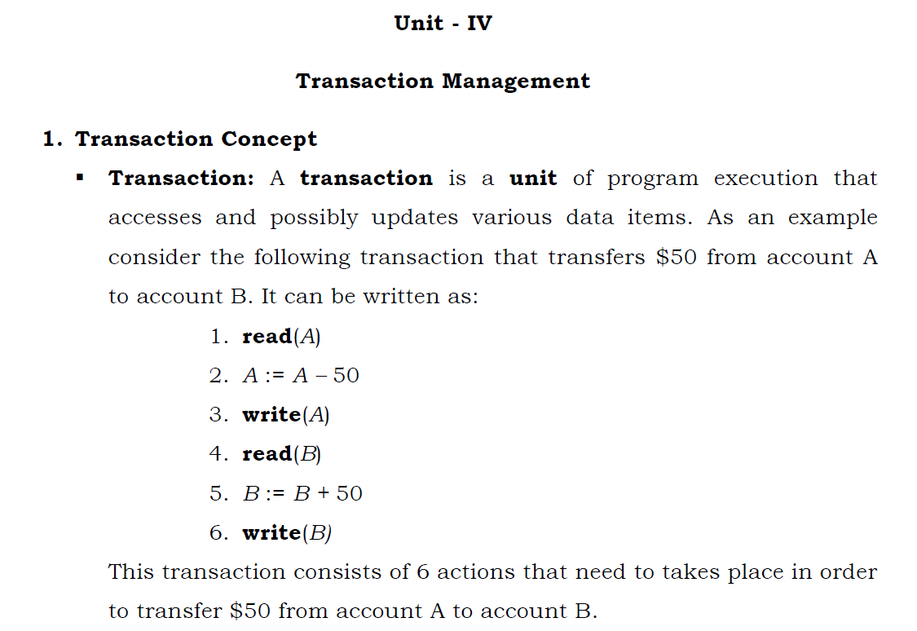

Slide 4
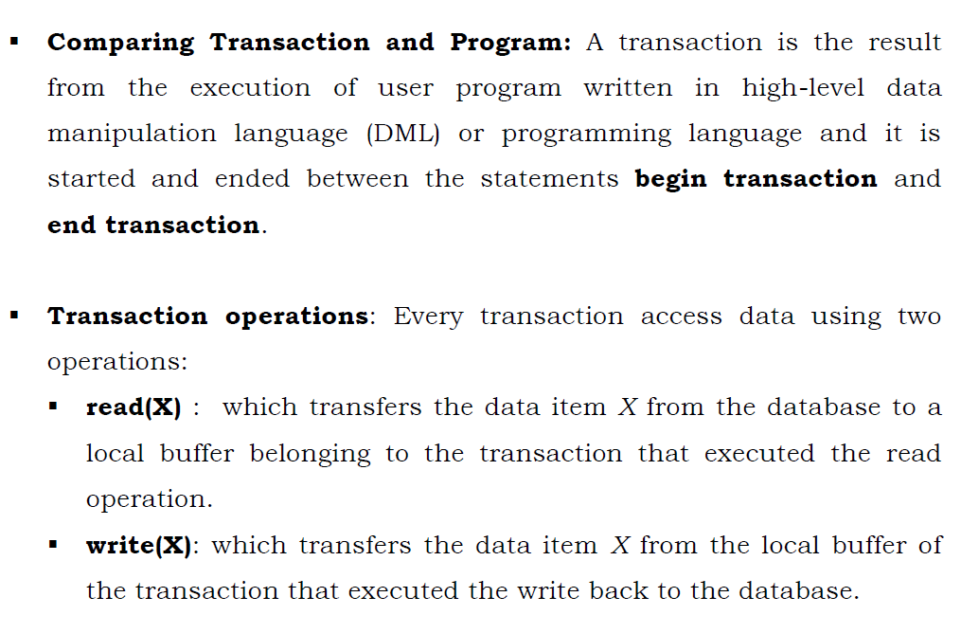

Slide 5
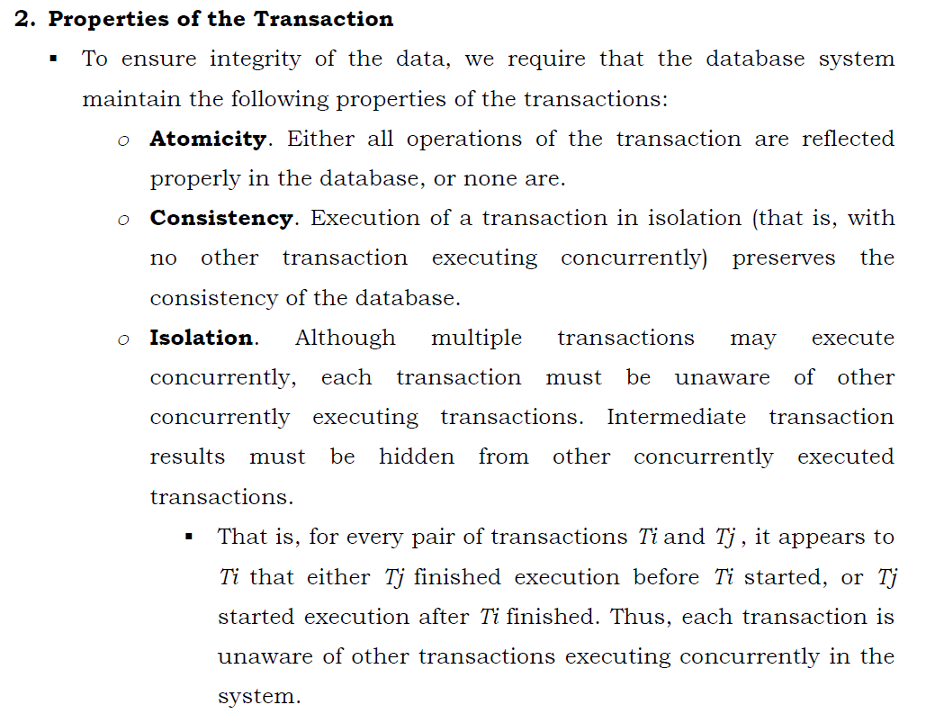

Slide 6
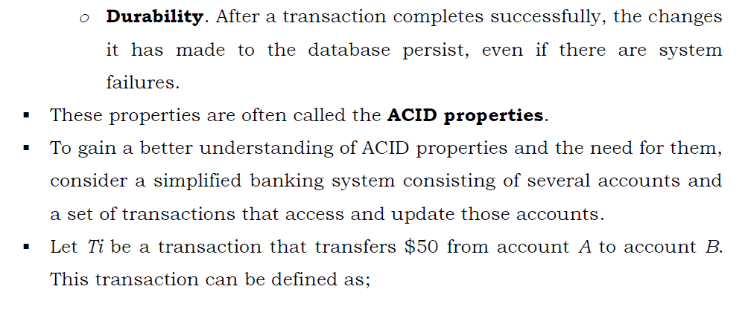

Slide 7
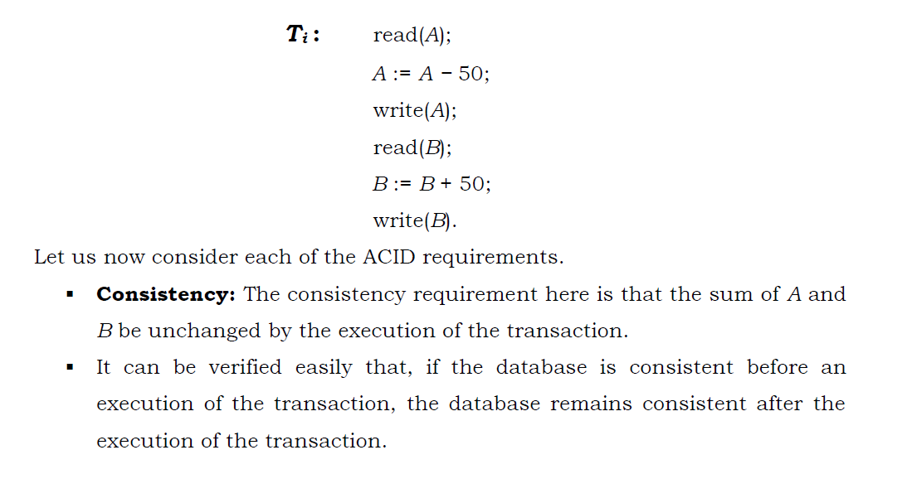

Slide 8
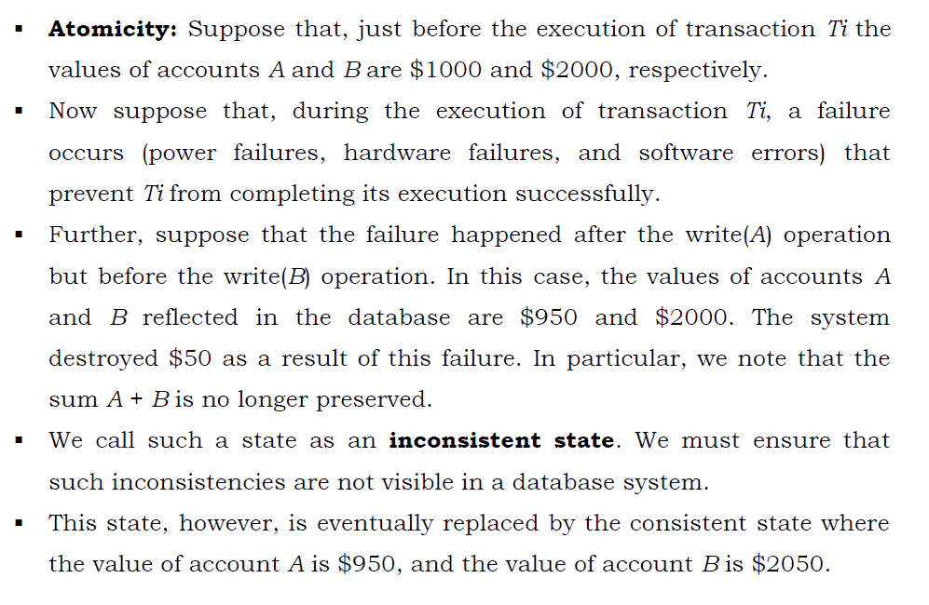

Slide 9
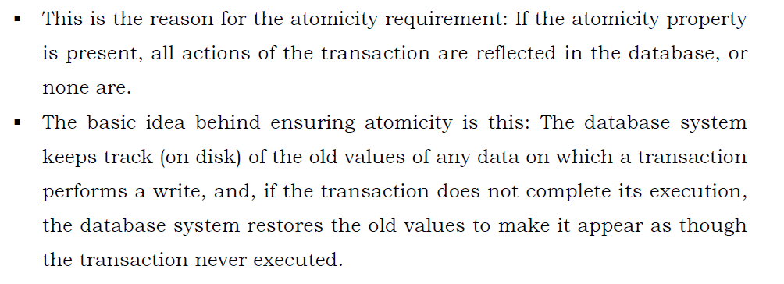

Slide 10
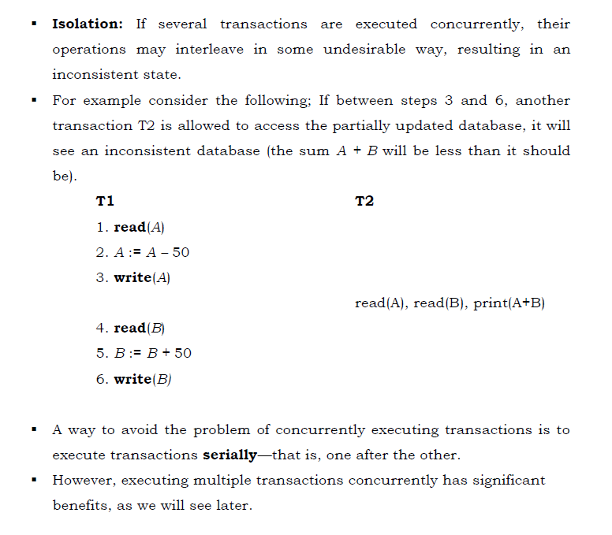

Slide 11
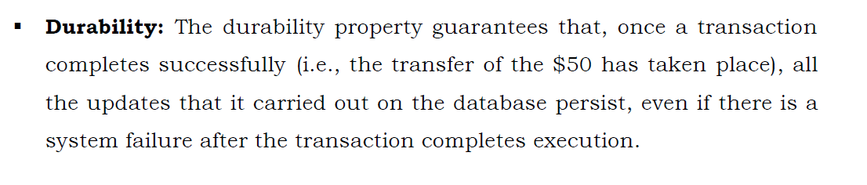

Slide 12
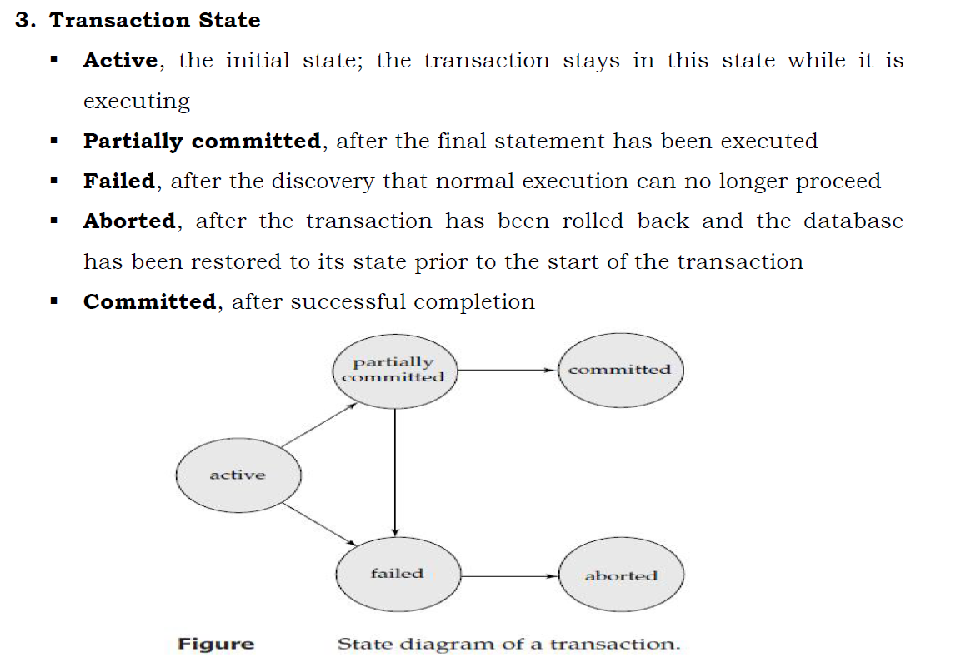

Slide 13
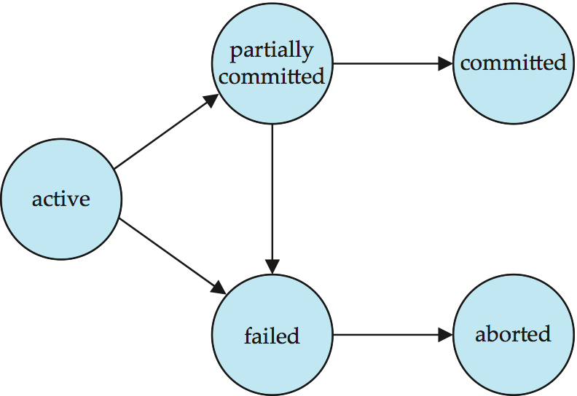

Slide 14
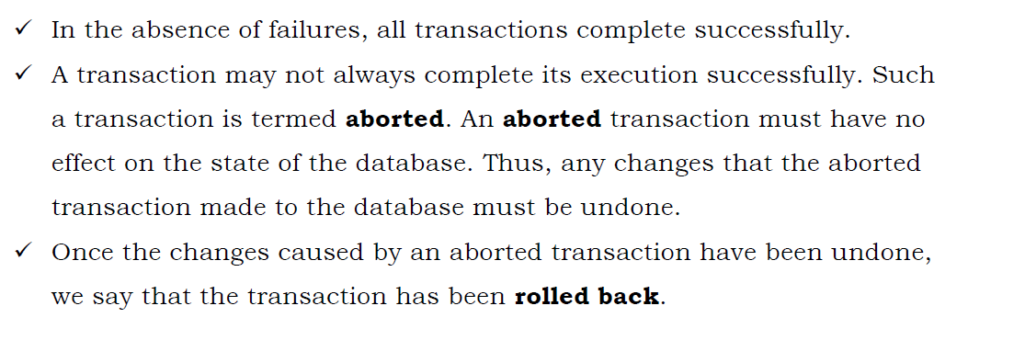

Slide 15
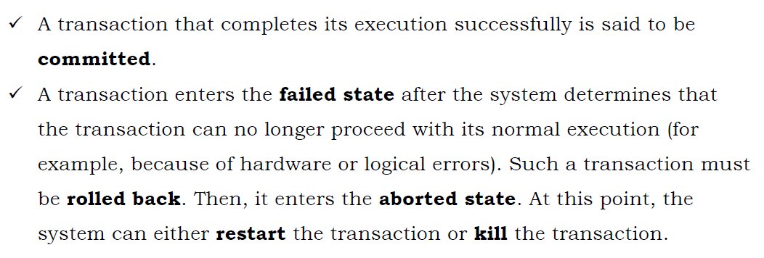

Slide 16
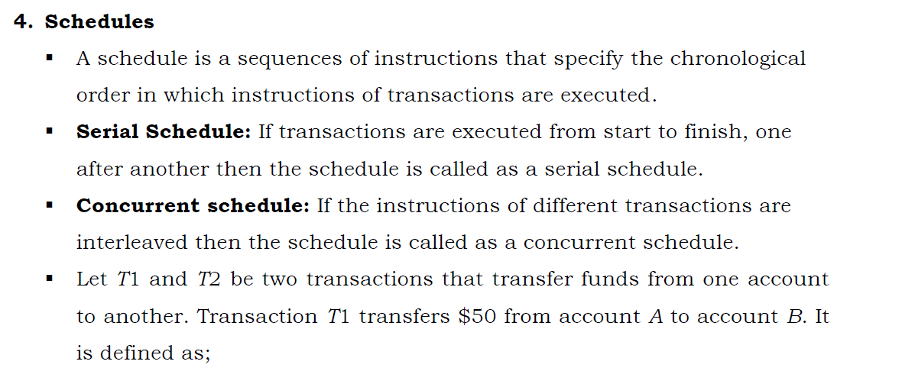

Slide 17
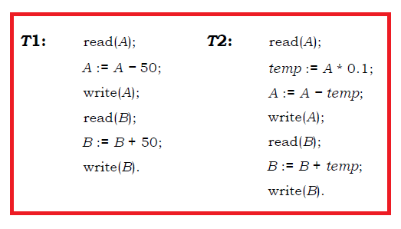
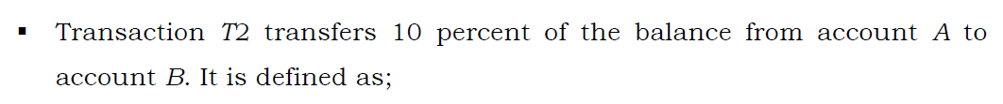

Slide 18
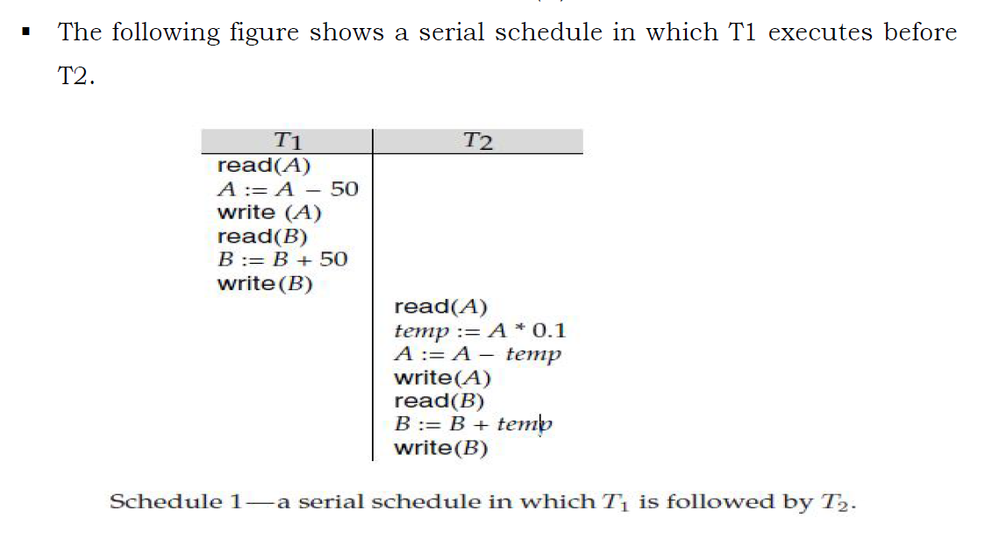

Slide 19
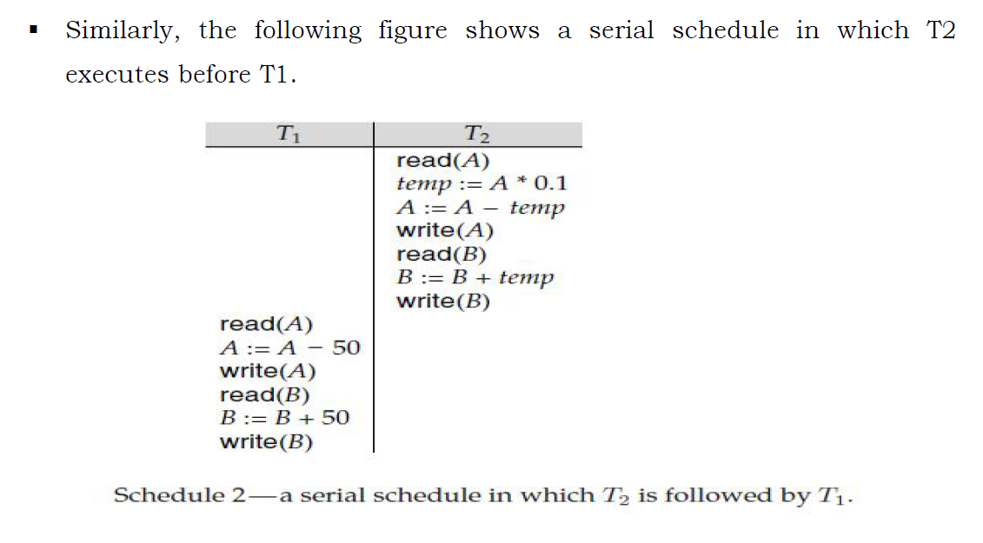

Slide 20
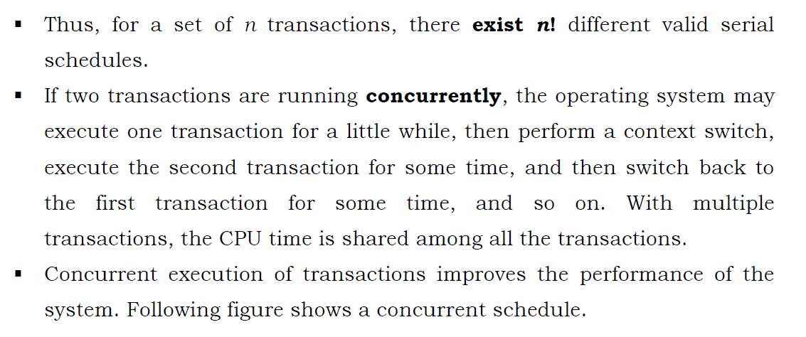

Slide 21
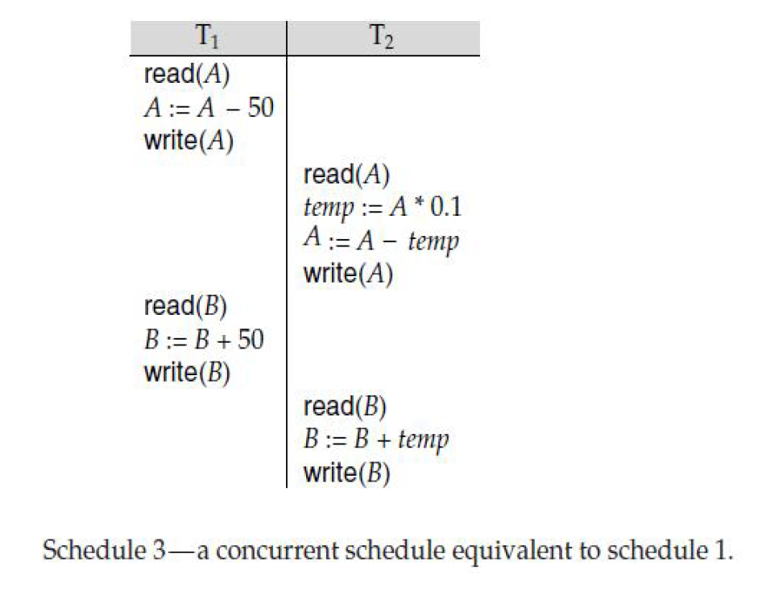

Slide 22
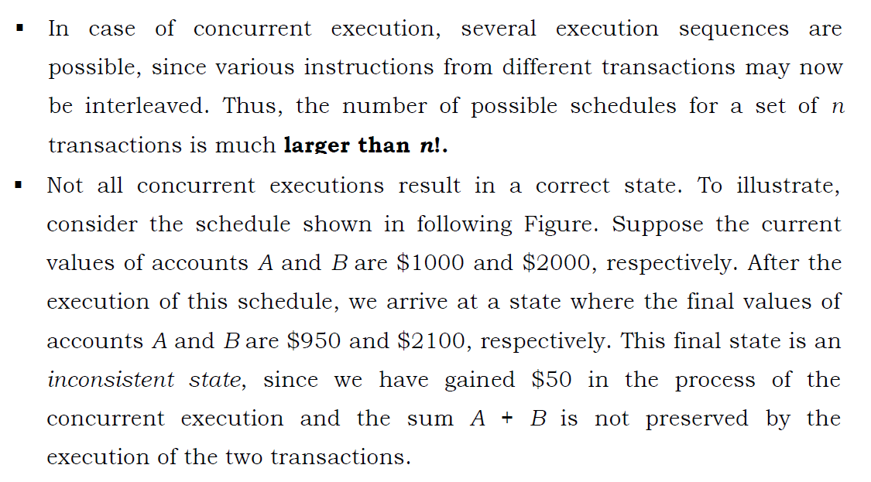

Slide 23
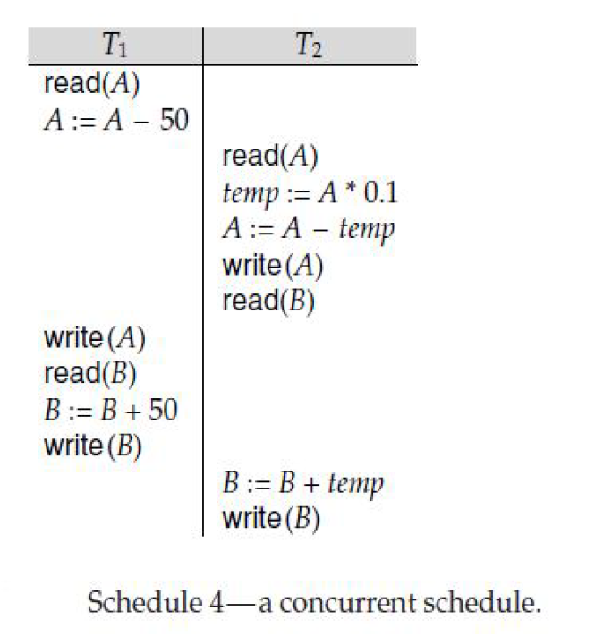

Slide 24
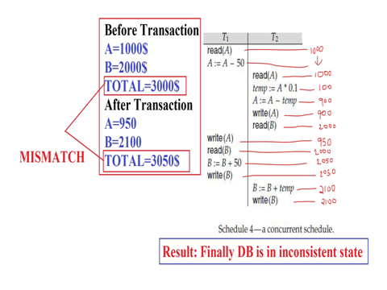

Slide 25
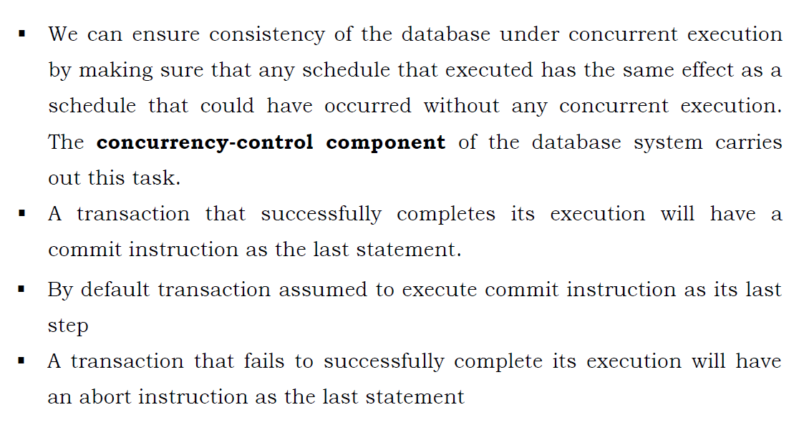

Slide 26
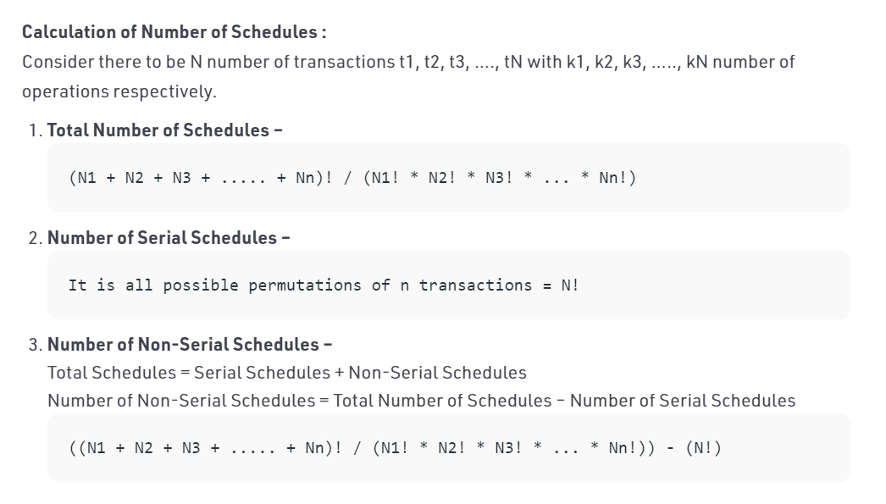

Slide 27
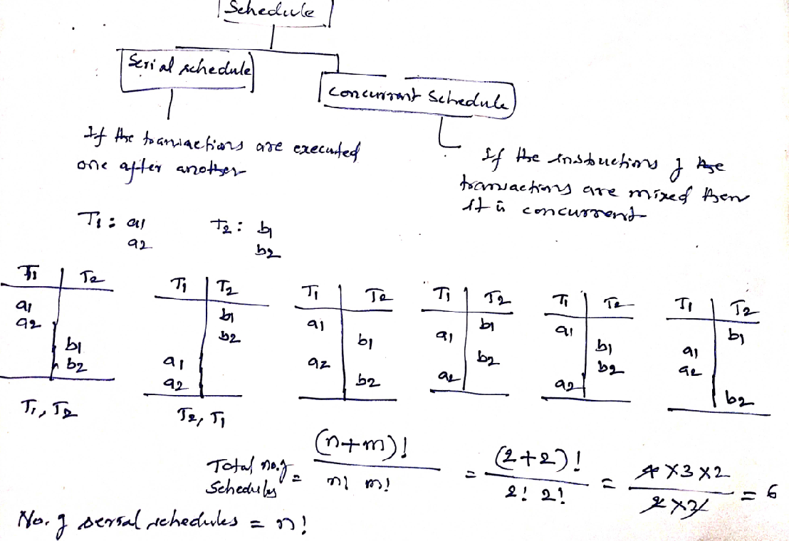

Slide 28
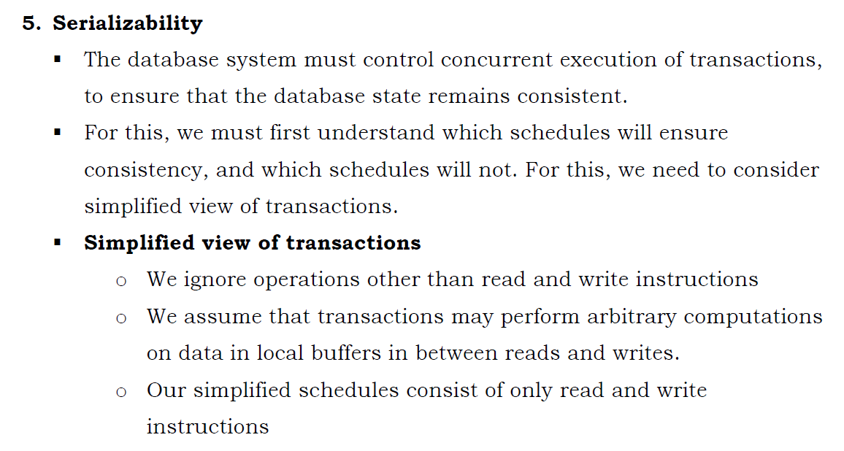

Slide 29
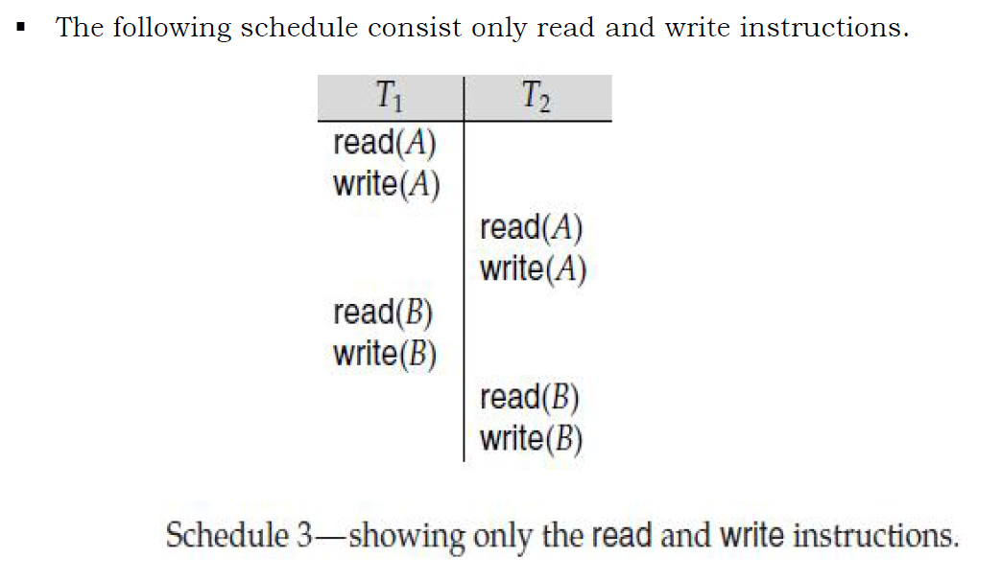

Slide 30
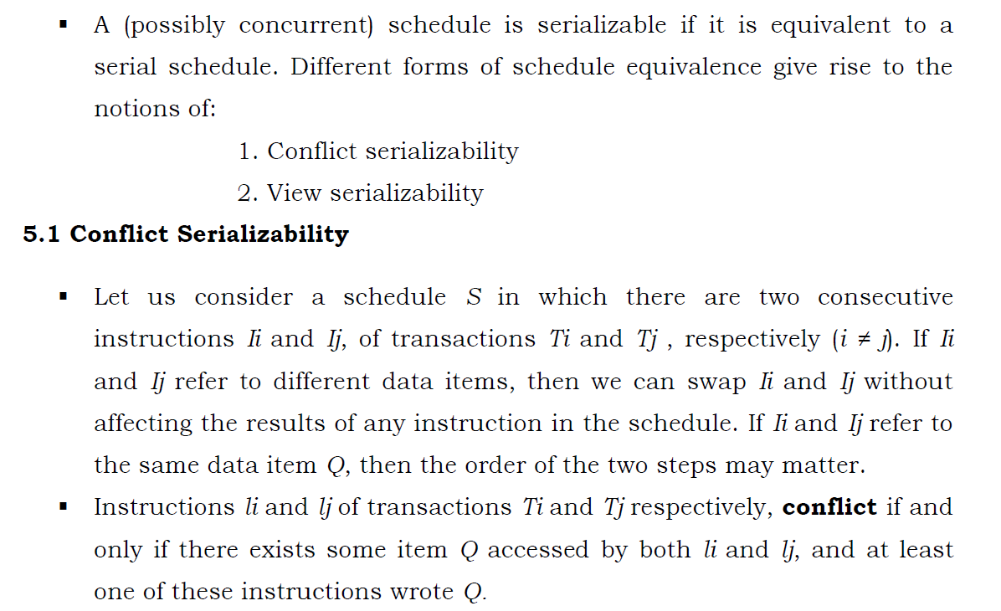

Slide 31
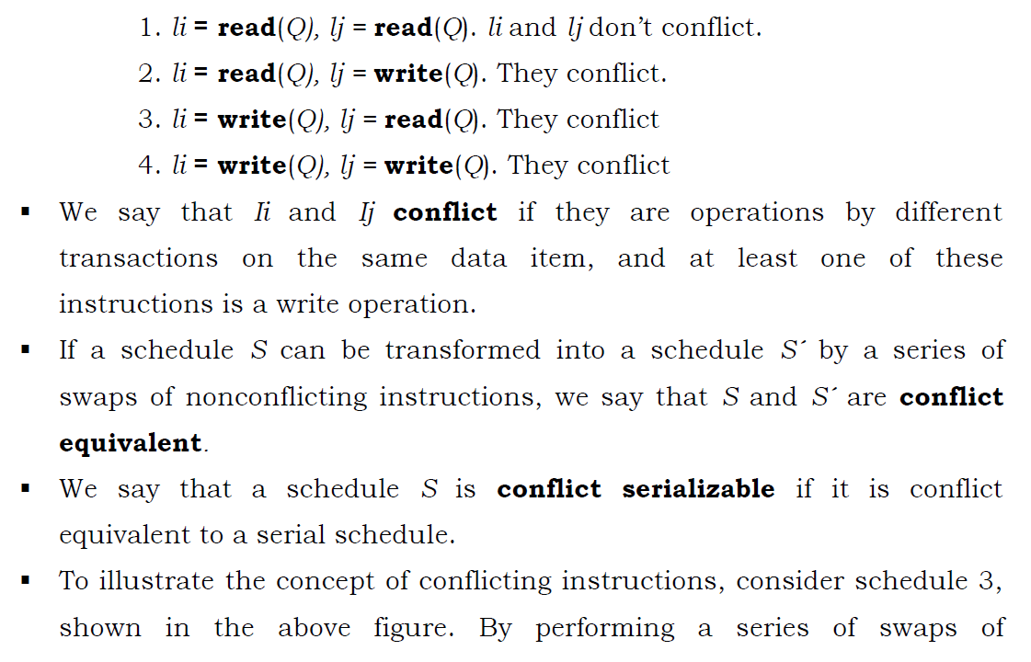

Slide 32
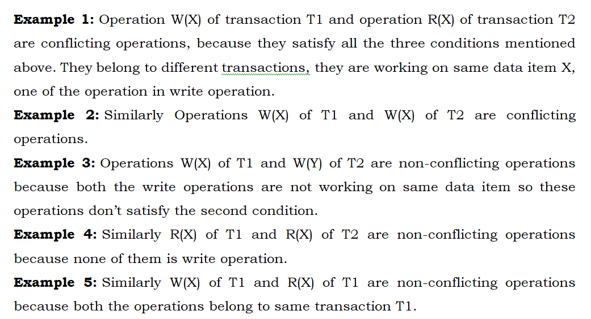
CONFLICTING INSTRUCTIONS & NON-CONFLICTING INSTRUCTIONS

Slide 33
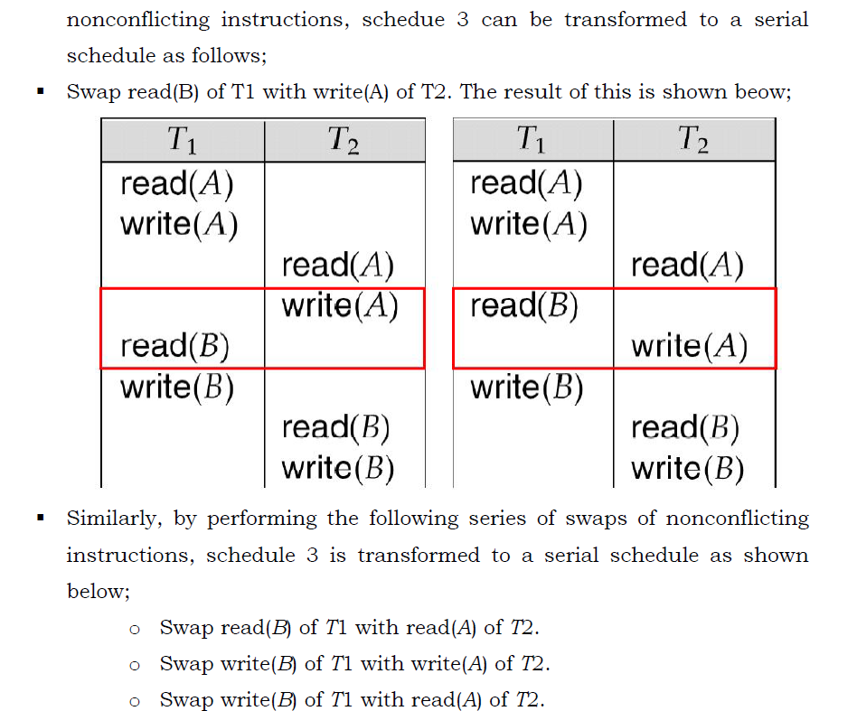

Slide 34
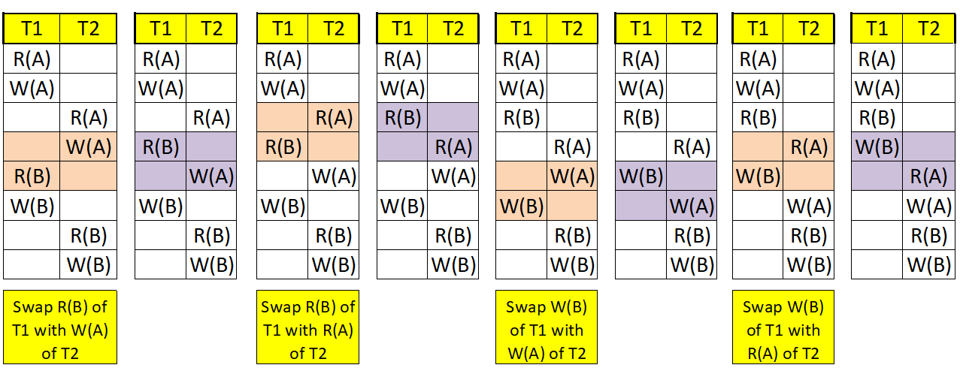

Slide 35
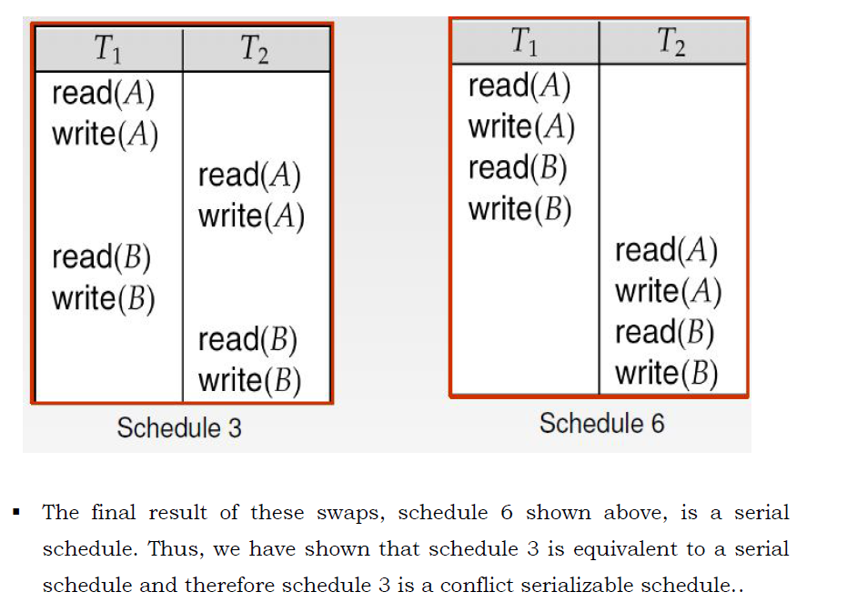

Slide 36
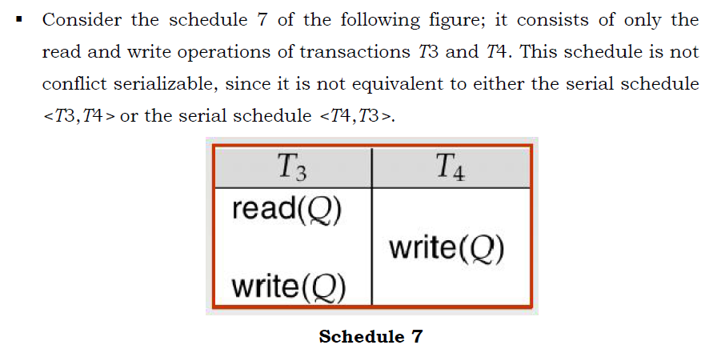

Slide 37
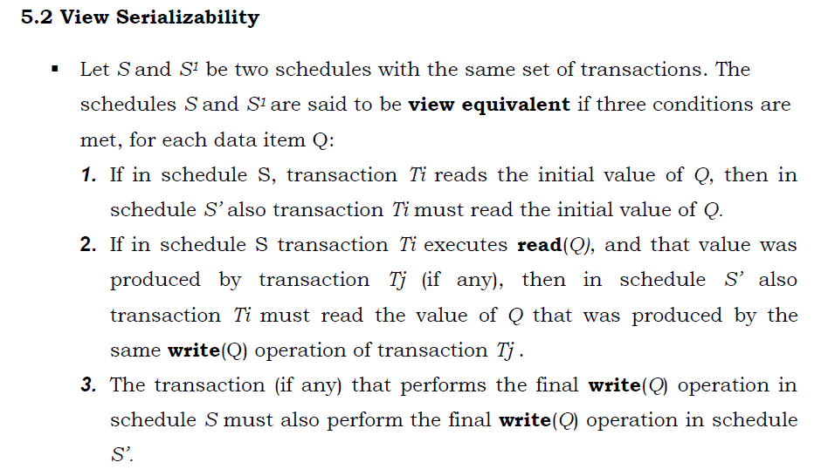

Slide 38
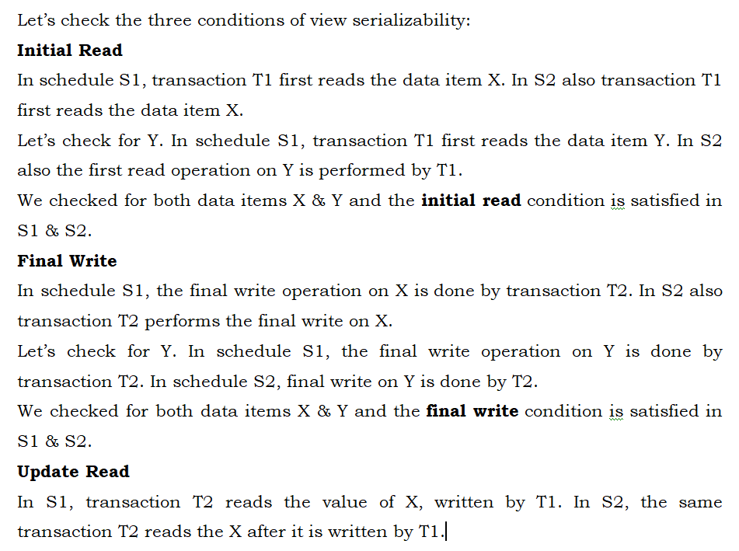

Slide 39
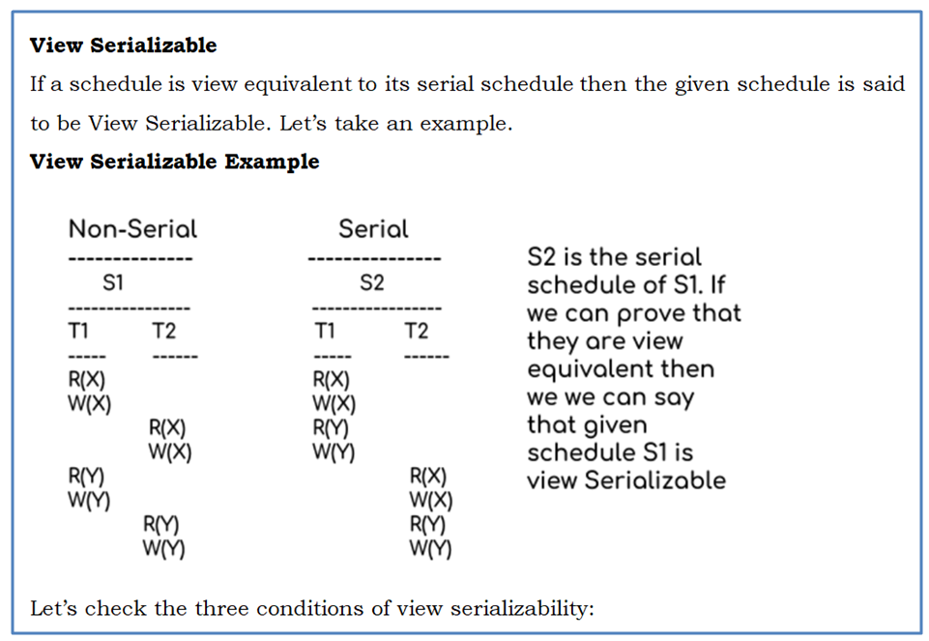

Slide 40
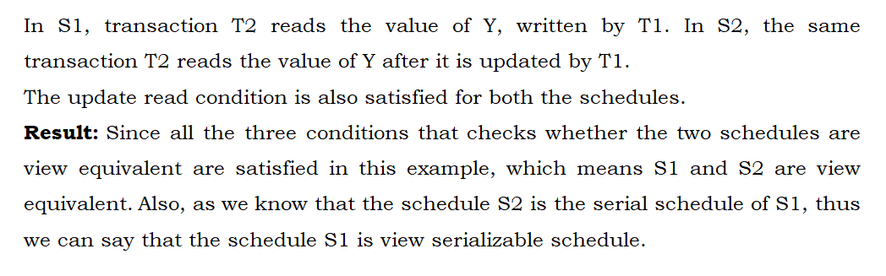

Slide 41
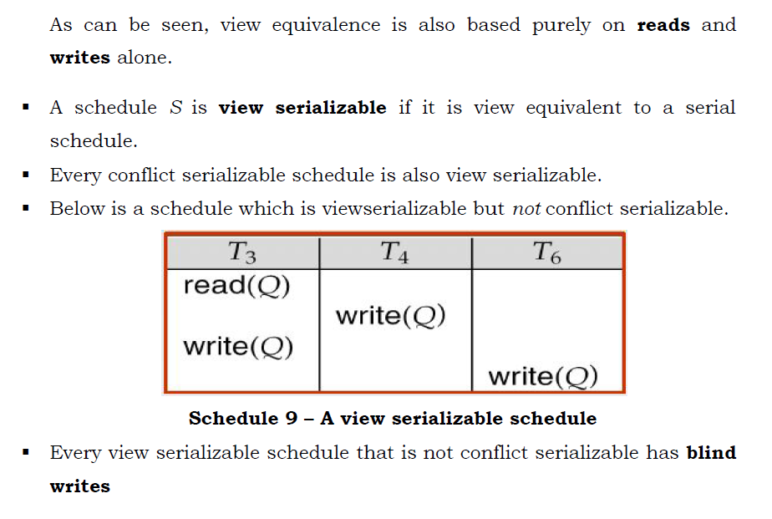

Slide 42
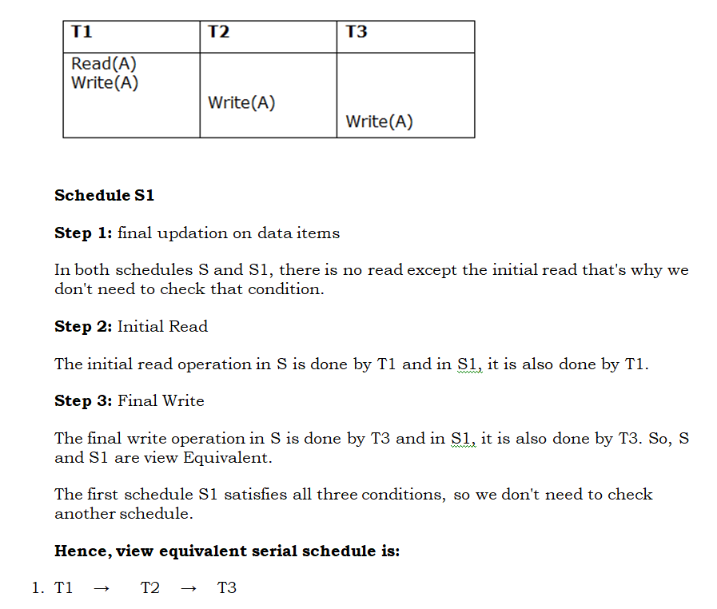
EXAMPLE

Slide 43
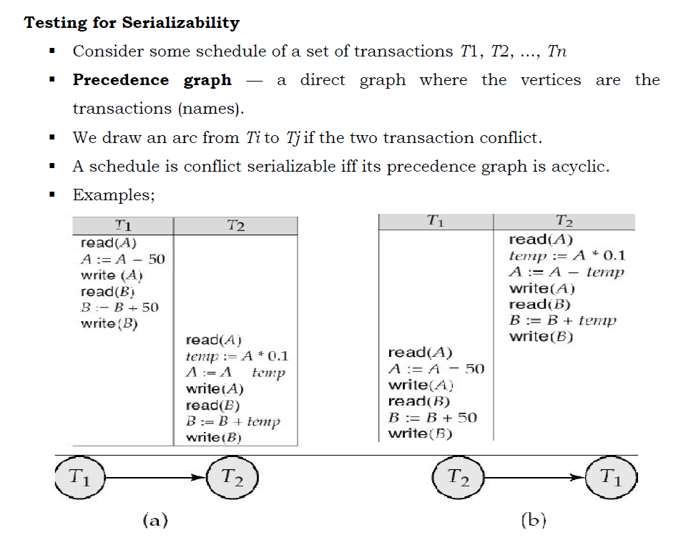

Slide 44
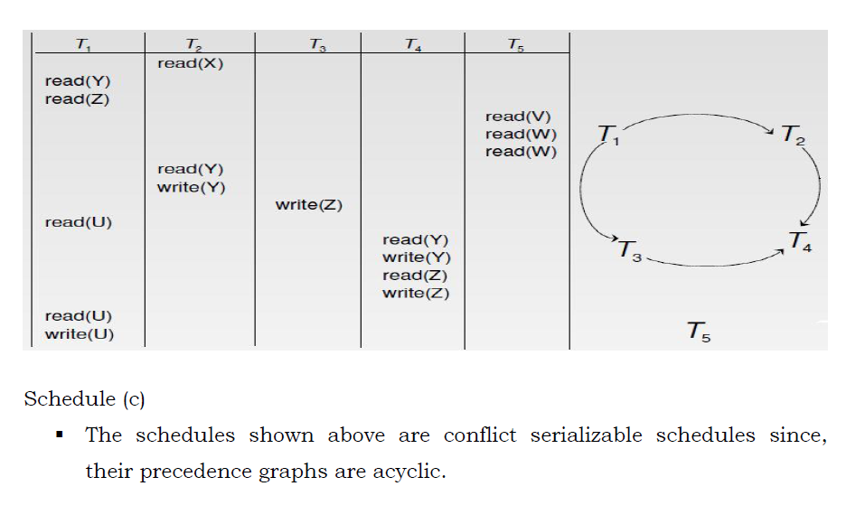

Slide 45
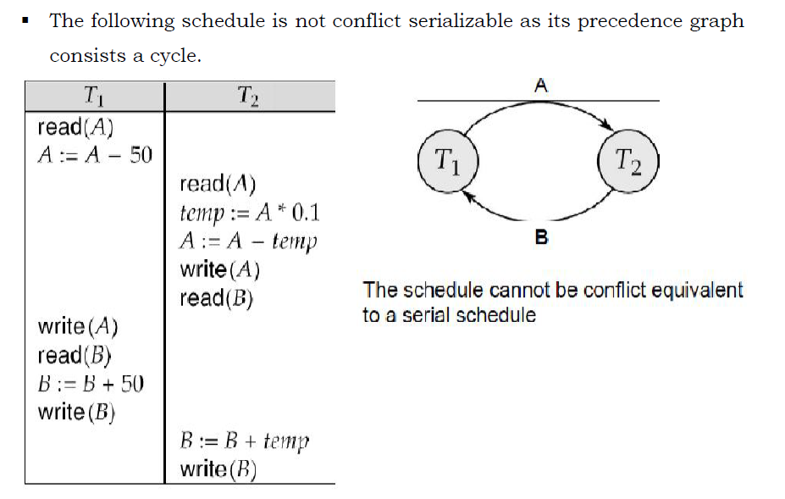

Slide 46
RECOVERABILITY

Slide 47
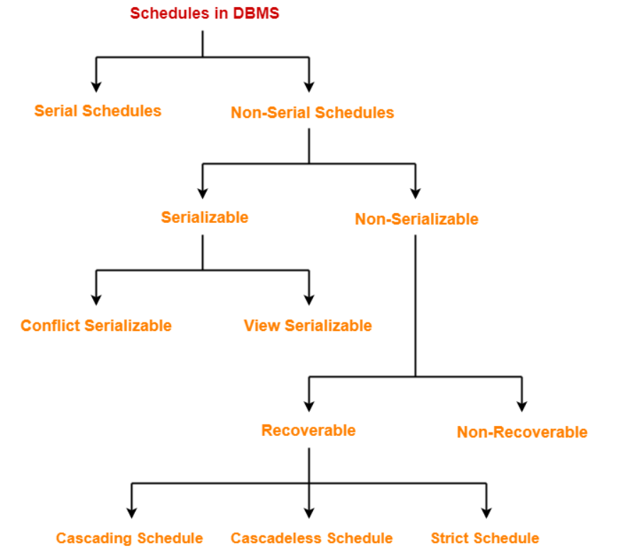

Slide 48
Non-Serializable Schedules-
A non-serial schedule which is not serializable is called as a non-serializable schedule.
A non-serializable schedule is not guaranteed to produce the the same effect as produced by some serial schedule on any consistent database.
Characteristics-
Non-serializable schedules-
may or may not be consistent
may or may not be recoverable

Slide 49
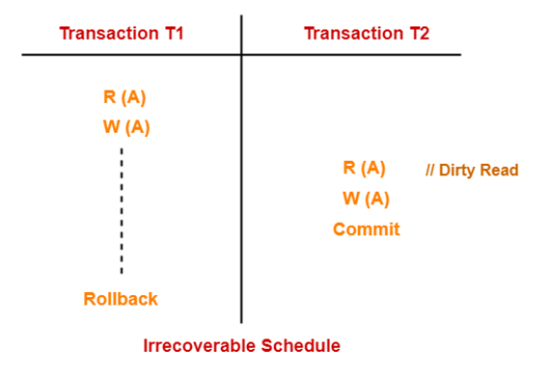
Irrecoverable Schedules-
If in a schedule,
A transaction performs a dirty read operation from an uncommitted transaction
And commits before the transaction from which it has read the value
then such a schedule is known as an Irrecoverable Schedule.
Example-
Consider the following schedule-
Here,
T2 performs a dirty read operation.
T2 commits before T1.
T1 fails later and roll backs.
The value that T2 read now stands to be incorrect.
T2 cannot recover since it has already committed.

Slide 50
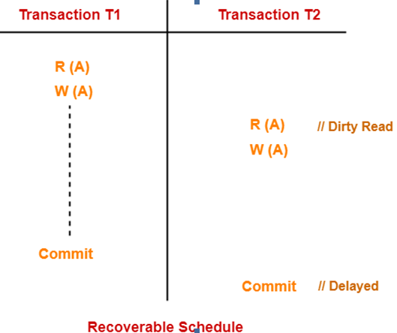
Recoverable Schedules-
If in a schedule,
A transaction performs a dirty read operation from an uncommitted transaction
And its commit operation is delayed till the uncommitted
transaction either commits or roll backs then
such a schedule is known as a Recoverable Schedule.
Here,
The commit operation of the transaction that performs the
dirty read is delayed.
This ensures that it still has a chance to recover if the
uncommitted transaction fails later.
Example-
Consider the following schedule-
Here, T2 performs a dirty read operation.
The commit operation of T2 is delayed till T1 commits or roll backs.
T1 commits later.
T2 is now allowed to commit.
In case, T1 would have failed, T2 has a chance to recover by rolling back.

Slide 51
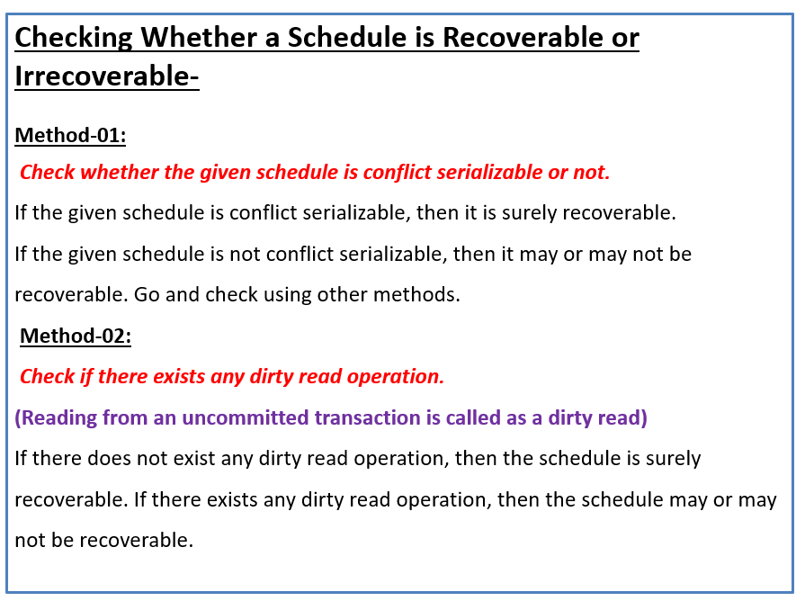

Slide 52
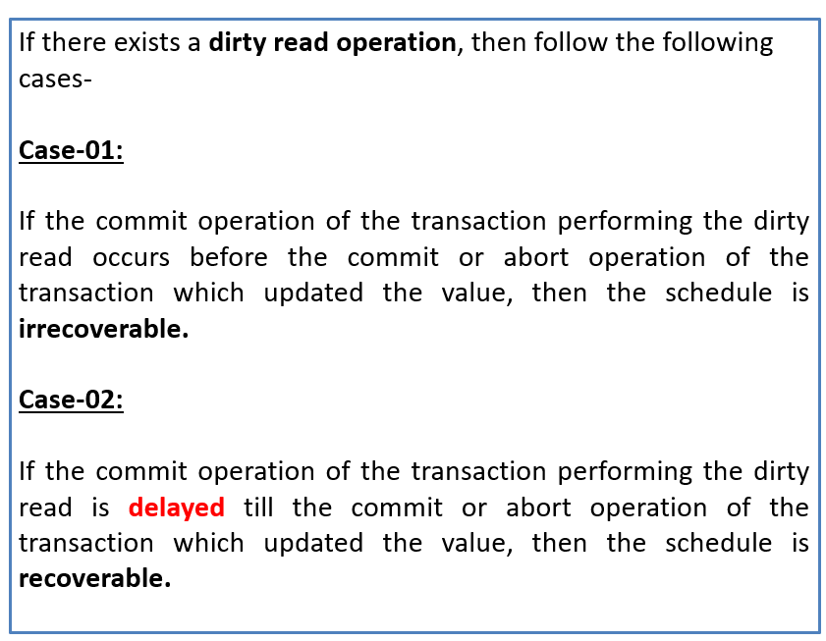

Slide 53
Recoverable Schedules-
If in a schedule,
A transaction performs a dirty read operation from an uncommitted transaction and its commit operation is delayed till the uncommitted transaction either commits or roll backs
then such a schedule is called as a Recoverable Schedule.
Types of Recoverable Schedules-
A recoverable schedule may be any one of these kinds-
Cascading Schedule
Cascadeless Schedule
Strict Schedule

Slide 54
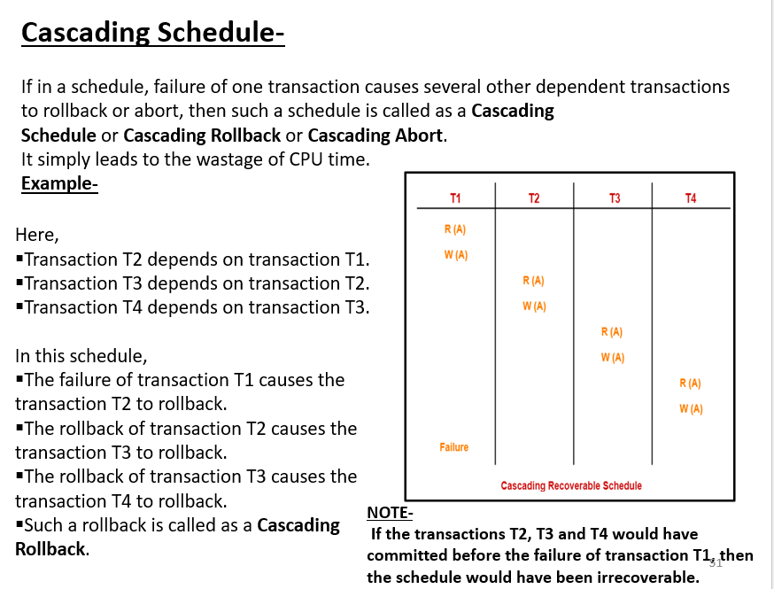

Slide 55


Slide 56


Slide 57

Remember-
Strict schedules are more strict than cascadeless schedules.
All strict schedules are cascadeless schedules.
All cascadeless schedules are not strict schedules.

Slide 58


Slide 59


Slide 60


Slide 61



Slide 62


Slide 63


Slide 64


Slide 65


Slide 66


Slide 67


Slide 68


Slide 69


Slide 70


Slide 71


Slide 72


Slide 73


Slide 74


Slide 75


Slide 76


Slide 77


Slide 78


Slide 79

ANOTHER WAY OF DEFINING Wait-Die AND Wound-Wait

Slide 80


Slide 81



Slide 82


Slide 83


Slide 84


Slide 107
SELF-ASSESSMENT QUESTIONS
Which of the following is a benefit of normalization in database design?
Reduced data redundancy
Decreased data consistency
Improved data integrity
Reduced storage space
Which normal form requires that all non-key columns in a table be dependent only on the primary key and not on other non-key columns?
First Normal Form (1NF)
Second Normal Form (2NF)
Third Normal Form (3NF)
Fourth Normal Form (4NF)

Slide 108
REFERENCES FOR FURTHER LEARNING OF THE SESSION
Reference Books:
1. Database System Concepts by Abraham Silberschatz, Henry F. Korth, and S. Sudarshan
2. Fundamentals of Database Systems by Ramez Elmasri and Shamkant B. Navathe

Slide 109
THANK YOU
Team – DBMS

